Slide 1




The Staircase Mechanism in Differential Privacy
This research paper discusses an alternative noise-adding mechanism called the staircase mechanism in differential privacy.
Shambhoolal Narwaria 21114095 Artificial Intelligence

Slide 2
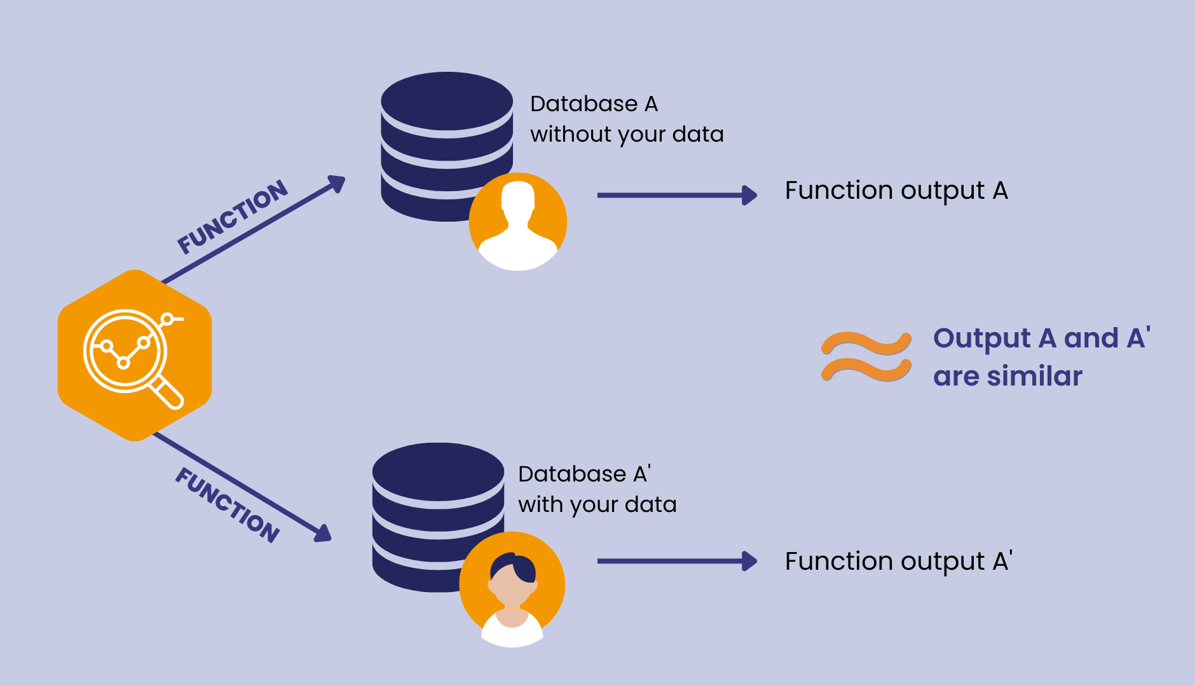
INTRODUCTION
Differential privacy is a mathematical framework for ensuring the privacy of individuals in datasets. It can guarantee privacy by allowing data to be analyzed without revealing sensitive information about any individual in the dataset.
The key idea of differential privacy: the presence or absence of any individual data in the database should not significantly affect the final released statistical information

Slide 3
STAIRCASE MECHANISM
Differential privacy mechanisms, such as the Laplace mechanism, are commonly used to ensure individual privacy in datasets.
However, the author discusses the staircase mechanism, a geometric mixture of uniform random variables, which can replace the standard Laplace mechanism in differential privacy. The staircase mechanism improves performance, particularly in medium-low privacy regimes, and is considered an optimal noise-adding mechanism.

Slide 4
STAIRCASE ALGORITHM
Input:
Є (epsilon) – privacy parameter: A smaller value indicates a higher level of privacy.
Δ (delta) – global sensitivity: It reflects the maximum change in the query output caused by altering a single element in the dataset. and
γ (gamma) – free parameter: It helps in noise distribution. It helps to set the fundamental tradeoff between utility(accuracy) and privacy.
Output:
X random variable with staircase distribution specified by Є, Δ, and γ parameters.

Slide 5
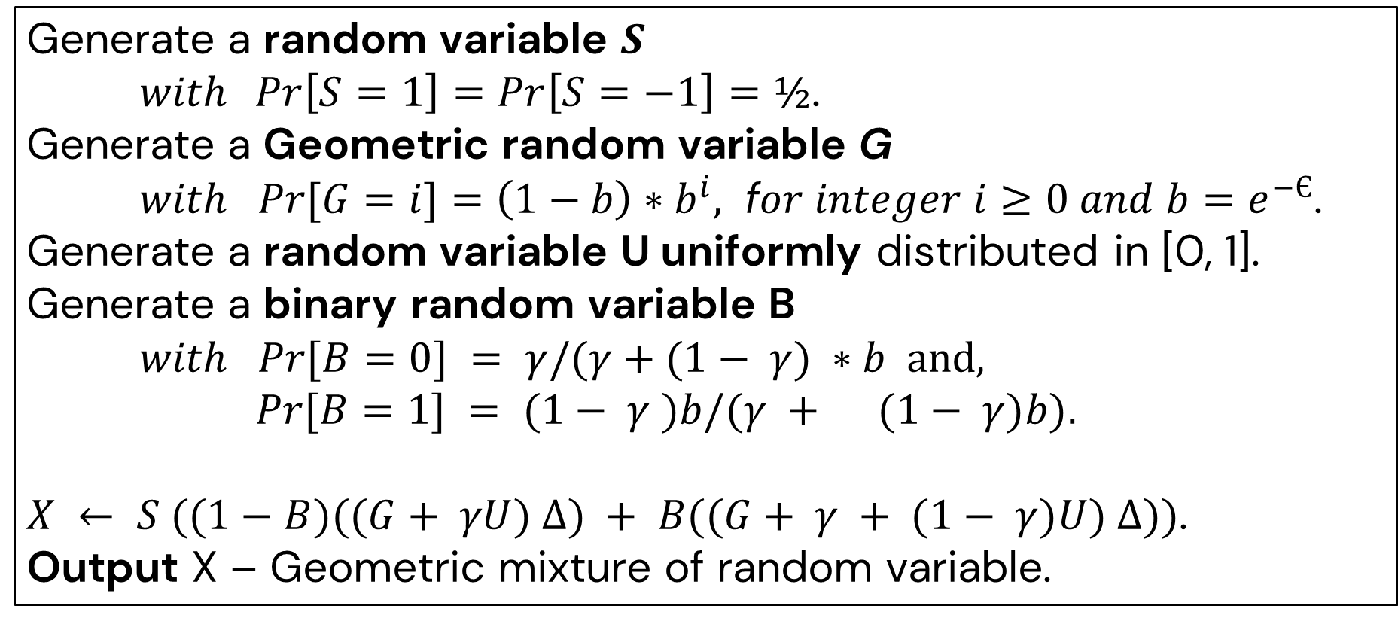
ALGORITHMS CONTINUE
Generate a random variable $S$
$with\operatorname{Pr}\left[S=1\right]=\operatorname{Pr}\left[S=−1\right]=½$.
Generate a Geometric random variable G
$with Pr⁡[G=i]=\left(1−b\right)∗b^{i},$ f$or integer i≥0 and b=$ $e^{−Є}$.
Generate a random variable U uniformly distributed in [0, 1].
Generate a binary random variable B
$with Pr⁡[B=0] = γ/(γ+(1− γ) ∗b$ and, $Pr⁡[B=1] = (1− γ )b/(γ + (1− γ)b).$
$X ← S ((1−B)((G+ γU) Δ) + B((G+ γ + (1− γ)U) Δ))$.
Output X – Geometric mixture of random variable.
02 - WEBSITE

Slide 6
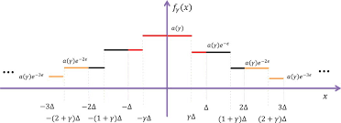
OPTIMAL PROPERTY
Decrease the noise aptitude: The Staircase mechanisms, using the ε-differential privacy constraint, aim to reduce noise aptitude by balancing the privacy and accuracy of individual data.
Staircase-Shaped Probability Density: Staircase mechanisms use staircase-shaped probability density functions for noise calculation, requiring less time complexity and providing faster privacy guarantees than the Laplace mechanism.
Geometric Mixture: The staircase mechanism can be viewed as a geometric mixture of uniform random variables and is very easy to generate algorithmically.

Slide 7
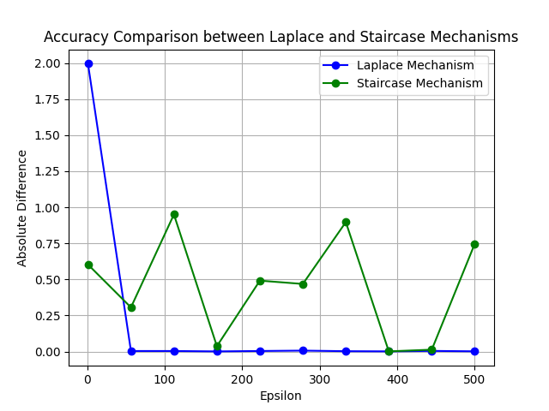
ACCURACY COMPARE
The staircase mechanisms add noise to the query function, which is controlled by the gamma value, but this is not available in Laplace mechanisms.

Slide 8
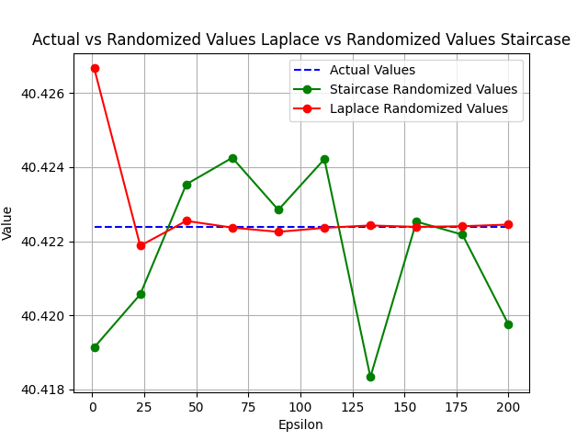
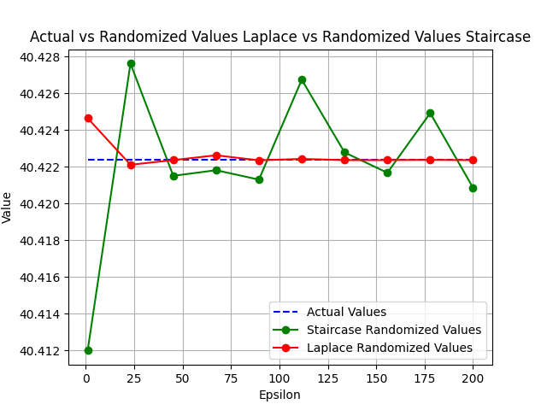
COMPARISON
STAIRCASE & LAPLACE
Gamma value 0
Gamma value 1
Both graphs show how the gamma value sets the balance between privacy and accuracy. As the gamma value increases, it decreases the privacy and otherwise improves the accuracy of the query function.
Laplace
Actual
Staircase

Slide 9
CONCLUSION
The staircase mechanism is the optimal version of the Laplace mechanism in differential privacy, offering improved performance over the standard Laplacian mechanism.
The proposed staircase mechanism offers a promising alternative to the standard Laplacian mechanism in preserving privacy while releasing useful aggregate information about individuals. The research paper suggests that the staircase mechanism can improve performance, especially in medium-low privacy regimes. If we implement that in both C++ programming, we found the staircase mechanisms are much faster than the Laplace mechanisms. It's almost two times faster.

Slide 10
THANK YOU

